Slide 1
Limiting Your Results

Slide 2

Overview
The WHERE clause
Relational operators
Pattern matching using LIKE Null values

Slide 3
SELECT first_name, last_name
FROM person;
Querying Specific Fields
Code returns first name and last name for every record in person table
SELECT keyword specifies fields of interest FROM specifies table where records are stored

Slide 4
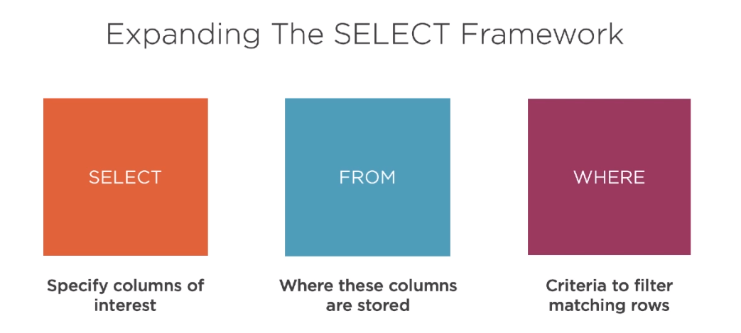

Slide 5




The WHERE Clause
SELECT first_name, last_name
FROM person
WHERE first_name = “Shelby”

Slide 6
Filtering Results
All records
Limiting criteria
SELECT first_name, last_name FROM person;
SELECT first_name, last_name FROM person
WHERE first_name = “Shelby”;
 | first_name | last_name
 | Katie | Brown
 | Brenna | Davis
 | Shelby | Garza
 | Brenda | Jones
 | Shelby | Smith
 | Tom | Stephens
 | Elmo | Nathanson
first_name | last_name
Shelby | Garza
Shelby | Smith

Slide 7
Criteria in the WHERE clause is case-sensitive

Slide 8
Comparison Operators
=
Equal
<>
Not equal
>
Greater than
<
Less than
>=
Greater than or equal
<=
Less than or equal

Slide 9

SELECT city,
Population table
state,
population
FROM city_population WHERE city = “Louisville”;
 | city | state | Population
 | Boise | ID | 226,570
 | Cincinnati | OH | 301,301
 | Cleveland | OH | 385,525
 | Louisville | CO | 21,128
 | Louisville | KY | 616,261
 | Marquette | MI | 20,629
 | Seattle | WA | 724.745
city | state | Population
Louisville | CO | 21,128
Louisville | KY | 616,261

Slide 10
SELECT city,
Population table
state,
population
FROM city_population WHERE city = “Louisville” AND state = “KY”;
 | city | state | Population
 | Boise | ID | 226,570
 | Cincinnati | OH | 301,301
 | Cleveland | OH | 385,525
 | Louisville | CO | 21,128
 | Louisville | KY | 616,261
 | Marquette | MI | 20,629
 | Seattle | WA | 724.745
city | state | Population
Louisville | KY | 616,261
◀ Use AND to combine multiple criteria

Slide 11

Demo
Using comparison operators
Filtering for specific conditions

Slide 12
Matching Patterns
Relational operators match fields to a specific value
LIKE matches fields to a specific pattern

Slide 13
Functionality of LIKE
 | first_name | last_name
 | Katie | Brown
 | Brenna | Davis
 | Shelby | Garza
 | Brenda | Jones
 | Shelby | Smith
 | Tom | Stephens
 | Elmo | Nathanson
SELECT first_name, last_name FROM person
WHERE first_name = “Shelby”;
SELECT first_name, last_name FROM person
WHERE first_name LIKE “Shelby”;
first_name | last_name
Shelby | Garza
Shelby | Smith

Slide 14
Pattern Wildcards
Pattern to match can include wildcards
% represents zero or more characters
_ represents exactly one character

Slide 15
Demo
Implementing the LIKE keyword
Criteria for pattern matching

Slide 16
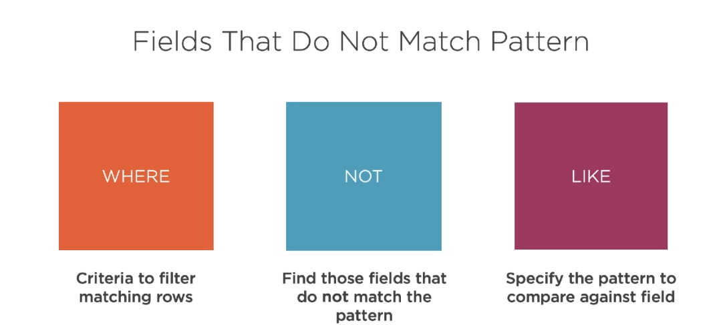

Slide 17
Dealing with messy data sets
Fuzzy-matching
Usefulness
Regular expressions

Slide 18
Null is not equivalent to zero
Null Values
Null indicates that the value of a field is missing or unknown
A field is null only when no data exists in that field

Slide 19
Representing Missing Data
first_name | last_name | age
Katie | Brown | 18
Brenna | Davis
Shelby | Garza | 26
Brenda | Jones | 25
Shelby | Smith | 41
Tom | Stephens | 35
Elmo | Nathanson | 38
Substituting 0 could skew calculations
Using a blank space character is poor practice
SQL recognizes an empty field as a null value

Slide 20
Keywords for Null Values
IS NULL
IS NOT NULL
This is the same as saying Field = “”
This is the same as saying Field <> “”

Slide 21
Keywords for Null Values
You cannot use standard relational operators to find null values
Must use IS NULL or IS NOT NULL syntax

Slide 22
Demo
Finding null values
Finding values that are not null

Slide 23
Checking for Nulls
Check for null values to diagnose issues in a dataset
Arithmetic operations that include a null value will always return a null value

Slide 24
Logical Operators
AND
OR
If a row from the table matches both conditions, it will be included
If a row from the table matches either condition, it will be included

Slide 25
SELECT first_name,
age
FROM person WHERE age >= 19 AND age <= 35;
SELECT first_name,
age
FROM person
WHERE age BETWEEN 19 and 35;
The BETWEEN Keyword
BETWEEN looks for matches within specified boundaries
Boundaries are inclusive

Slide 26





The BETWEEN Keyword
first_name | last_name | age
Katie | Brown | 18
Shelby | Garza | 26
Brenda | Jones | 25
Shelby | Smith | 41
Tom | Stephens | 35
Elmo | Nathanson | 38
WHERE AGE BETWEEN 19 AND 35
2
26
Shelby
38
Elmo
18
25
Brenda
35
41
Shelby
Katie
Tom

Slide 27
Instead of multiple OR statements
Can use the SQL keyword IN
The IN Keyword
Provide a list of options for a given field

Slide 28
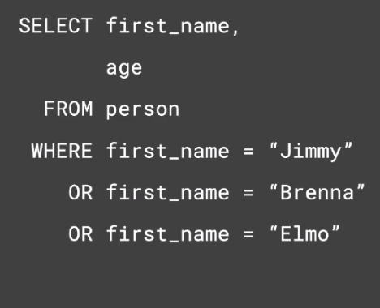
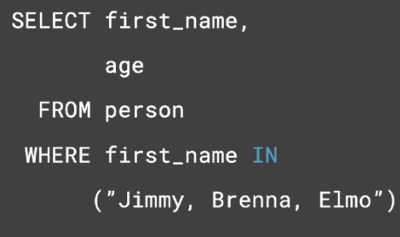
◀ Each matching value appears in
a list following the variable name
◀ Use IN to replaces multiple OR statements
◀ IN checks for equality conditions

Slide 29
The IN Keyword
NOT IN
Used to return records that do not match any of the listed values

Slide 30
Operator precedence
The sequence in which operations are performed

Slide 31
SELECT first_name,
last_name, hometown FROM person
WHERE first_name = “Shelby”
OR first_name = “Tom” AND hometown = “Boston”;
◀ AND has higher operator precedence than OR
first_name | last_name | hometown
Katie | Brown | Detroit
Brenna | Davis | Sacramento
Shelby | Garza | Boston
Brenda | Jones | Baltimore
Shelby | Smith | Denver
Tom | Stephens | Boston
Elmo | Nathanson | Orlando
first_name | last_name | hometown
Tom | Stephens | Boston
Shelby | Garza | Boston
Shelby | Smith | Denver

Slide 32
SELECT first_name,
last_name, hometown FROM person
WHERE (first_name = “Shelby”
OR first_name = “Tom”) AND hometown = “Boston”;
◀ SQL will evaluate contents of parentheses first
first_name | last_name | hometown
Katie | Brown | Detroit
Brenna | Davis | Sacramento
Shelby | Garza | Boston
Brenda | Jones | Baltimore
Shelby | Smith | Denver
Tom | Stephens | Boston
Elmo | Nathanson | Orlando
first_name | last_name | hometown
Tom | Stephens | Boston
Shelby | Garza | Boston

Slide 33
Use parentheses when writing complex expressions

Slide 34
Summary
WHERE prescribes criteria
Comparison operators
LIKE matches specific patterns AND and OR for multiple criteria

